Slide 1


PES COLLEGE OF ENGINEERING
(AN AUTONOMOUS INSTITUTE AFFILIATED TO VTU BELGAUM), (ACCREDITED BY NBA, NEW DELHI)
MANDYA - 571401
“Experimental characterization of mortar using bagasse ash and fly ash hybridization”
Final Project Presentation
By
ROHITH.R
USN: 4PS21CCS08
Under the guidance of
Dr. LAKSHMI P.S
Assistant professor
Department of Civil Engineering
PESCE, Mandya

Slide 2
TABLE OF CONTENTS
INTRODUCTION
LITERATURE REVIEW
OBJECTIVES OF PROPOSED WORK
METHODOLOGY
BRIEF DETAILS OF EXPERIMETNAL WORK
RESULTS AND DISCUSSIONS
CONCLUSIONS
REFERENCES

Slide 3
INTRODUCTION
300 million tons of sugarcane is produced in India itself which produces 10 million tons per year of bagasse ash. However, over the years, bagasse has been recognized as a valuable byproduct with multiple uses. One of the significant applications of bagasse is used as a renewable source of energy. Bagasse can be burned in boilers to produce steam, which, in turn, can be used for generating electricity or providing heat for industrial processes. The use of SCBA as an SCM to partially replace ordinary Portland cement not only helps reduce methane emissions from disposal of the organic waste and reduce the production of cement which is infamous for its high energy consumption and CO2 emission, but also can improve the compressive strength of cement-based materials (SUPAPRON WANSOM et al.)
Fly ash is a byproduct of coal combustion and is one of the most commonly generated industrial wastes globally. It is a fine, powdery substance that is carried away in the flue gas during the combustion of coal in power plants. It primarily consists of fine particles that contain inorganic materials such as silica, alumina, iron, calcium, and other trace elements. The physical and chemical properties of fly ash make it suitable for several applications. One of the significant uses of fly ash is in the construction industry. Due to its pozzolanic properties, fly ash can be used as a supplementary cementitious material in the production of cement-based products. (TOB et al.)

Slide 4
LITERATURE REVIEW
Abhish m et al. [1]: The paper presents the laboratory investigations carried out on Portland pozzolana cement (PPC) & Portland slag cement (PSC) both are blended cement (factory blended), 53 grade OPC concrete. Here physical properties of ingredient materials were determined in accordance with IS specifications. The investigation is carried out for M30 grade of concrete mix with W/C ratio of 0.43, 0.41, and 0.40 respectively. The design of concrete mix is carried out according to IS method. Tests are carried out for fresh concrete and hardened concrete according to IS code. It has been observed from experimental data that, the blended cement concrete is performing well when compared to conventional concrete. This is due to the fact that the effective diffusion coefficient of various cement particles. However study is to be carried out longer term to ascertain the strength behavior of concrete.
B. T Naveen Kumar et al. [2]: In this paper the Ordinary Portland cement containing fly ash is used as blended cement to prepare the concrete mix. M 30 grade concrete with water cement ratio of 0.45 is used for the study. The project work involves casting of cubes (150mm x 150mm x 150mm), cylinders (150mm diameter and 300mm height) and prism (100mm x 100mm x 500mm). The concrete specimens are cured under water for 28 days and expose to 400°C, 600°C, and 800°C for 1 hour. The compressive strength, spilt tensile strength and flexure strength are measured for these specimens and compared with the strength of conventional concrete. The strength of each mix is found to increase compared to conventional concrete and a greater increase in strength is observed in mix with partial replacement with nano-metakaolin. The strength is found to increase up to 600°C and showed to reduction at 800°C

Slide 5
Chandrasekhar Reddy K et al.[4] : In this paper two distinct waste materials, such as palm oil fuel ash (POFA) and sugar cane bagasse ash (SCBA), are used as basic materials in this research, with weight fractions of 0%, 5.0%, 10.0%, 15.0%, 20.0%, and 25.0%, respectively, to substitute for grade 50 MPa concrete. Mechanical properties such as flexural strength, tensile and compressive strength of hybrid reinforced blended concrete were examined in the primary phase at 28 days of age. From the experimental investigation, mechanical properties are enhanced, and higher compressive and flexural strength are achieved as 64 MPa and 7.93 MPa in addition to 20% POFA and SCBA particles. The durable properties of quaternary blended concrete are enhanced properties due to the addition of hybrid materials.
Chow Wee Kang et al.[3] : The main purpose of this study is to investigate the effects of different combinations of ternary blended mortars incorporating supplementary cementitious materials such as Ground Granulated Blast Furnace Slag (GGBS) and Densified Silica Fume (DSF). In this study, mortars were prepared with 100% quarry dust and GGBS was replaced with DSF at 2% step increments up to 16% at a w/b ratio of 0.24. At the same time OPC content was fixed at 50%. The compressive and flexural strength, drying shrinkage, and porosity of mortars were all tested. The results indicated that the GGBS reduces the superplasticizer dosage for the desired workability of the mortar. The utilization GGBS and DSF has improved the performances ternary blended mortar incorporating quarry dust as a fine aggregate in terms of mechanical strength, drying shrinkage and total porosity tested. The high strength ternary blended mortar incorporating GGBS and DSF exhibited optimum mechanical and durability performance at the OPC: GGBS: DSF ratio of 50:38:12.

Slide 6
Dodda Srinivas et al.[7] : This paper represents a study on the strength, durability, and corrosion resistance of quaternary blended mortar made with Portland pozzolana cement (PPC), ground granulated blast furnace slag (GGBS) and rice husk ash (RHA) exposed to marine environment. Binary blended concrete mix using GGBS and RHA as partial replacement for cement is already well established. The optimized quaternary blended mortar specimen’s show improved mechanical strengths, both compressive and flexural. These specimens also exhibit enhanced resistance to chloride penetration, corrosion, and water absorption compared to the control mix after 28 days of water curing. A quaternary blended mortar mix prepared with 70% PPC, 20% GGBS, and 10% RHA exhibits the maximum mechanical strength, resistance to chloride penetration, and corrosion, mass loss and water absorption upon exposure to marine environment up to a period of 180 days.
Jorge I tobon et al.[8] : In this paper the effects of Nano silica (NS) on porosity, capillary suction (UNE 8398:2008), compressive strength (ASTM C 349), and sulfate resistance (ASTM C 1012) were evaluated for mortars made with Portland cement (control) and partially replaced with a commercial NS suspension, in percentages by weight of 0%, 1%, 3%, 5%, and 10%. Mortars with a water/binder (w/b) ratio of 0.55 and addition of superplasticizer, for flow correction, were prepared. The improvement of compressive strength is significantly higher in samples with 10 wt. % of NS, after 1 curing day they achieve an increase near to 120% in comparison to the control sample and at other curing ages the increment is close to 80%. In the assessment of sulfate resistance, it was found that, mortars with 5 and 10 wt. % NS decreased expansion by 90% and 95%, respectively after 2 years of immersion.

Slide 7
P. M bobby et al. [26] : This paper aims to consolidate the studies conducted on the performance of blended concrete in Marine environment and compare with an experimental analysis. The studies conducted by the researchers all over the world have already derived the applicability of blended concrete in most aggressive environment like marine applications. The main impact of supplementary cementing material is the reduced chloride intrusion thereby reduction in reinforced corrosion. An experimental study was also conducted to analyze the performance of multi blended cement concrete in marine environment. The ternary blended concrete exhibits very good corrosion resistance properties with a nominal reduction in compressive and split tensile strength. And the very good flexural strength in marine environment.
Sheba babu et al.[10] : The aim of this experimental study was to investigate the durability aspects in terms of the changes in mechanical properties of cement mortar specimens made with OPC and different combinations of various Supplementary Cementitious Materials (SCMs) exposed to ammonium based salt solution prepared using chemical grade ammonium chloride (NH4Cl). The mortar specimens were exposed to ammonium chloride solution in two different concentrations (1.25 M and 2.5 M) for a maximum exposure duration of two and half months. The changes in the mechanical properties were evaluated on the basis of visual assessment, depth of penetration, changes in the compressive strength, changes in Ultrasonic Pulse Velocity (UPV) and relative dynamic modulus of elasticity. From all the test results, it can be concluded that the ternary blended mix with OPC, GGBS and Silica fume (OPC-GGBS-SF) has higher resistance to ammonium chloride attack. The results stress the need to include SCMs and the importance to tailor the concrete for structures exposed to aggressive environment like ammonium chloride. . The SCMs used for the study include Class F Fly ash (FA), Ground Granulated Blast Furnace Slag (GGBS).

Slide 8
Yun -Feng Li et al.[12] : cement mortar with different steel slag kinds and different dosage of admixtures are studied. Experiments results show the effect of steel slag powder on performance of cement mortar and concrete. When compound mineral admixtures with steel slag powder and blast-furnace slag powder are mixed into, the performance of cement mortar and concrete can be improved further due to the synergistic effect and activation each other. The mineral admixture will be a perfect component of green concrete and its utilization will be a valuable resource for recycling. Compressive and flexural strength of concrete with steel slag powder tend to decrease as the content of steel slag increases. Properties of concrete will be greatly enhanced when compound mineral admixture of steel slag powder and blast furnace slag is mixed into concrete.
Yen li et al.[11] : Waste materials with pozzolanic characteristics, such as sewage sludge ash (SSA), coal combustion fly ash (FA), and granulated blast furnace slag (GBS), were reused as partial cement replacements for making cement mortar in this study. Experimental results revealed that with dual replacement of cement by SSA and GBS and triple replacement by SSA, FA, and GBS at 50% of total cement replacement, the compressive strength (Sc) of the blended cement mortars at 56 days was 93.7% and 92.9% of the control cement mortar, respectively. GBS had the highest strength activity index value and could produce large amounts of CaO to enhance the pozzolanic activity of SSA/FA and form calcium silicate hydrate gels to fill the capillary pores of the cement mortar. Consequently, the Sc (compressive strength) development of cement mortar with GBS replacement was better than that without GBS, and the total pore volume of blended cement mortars with GBS/SSA replacement was less than that with FA/SSA replacement. In the cement mortar with modified SSA and GBS at 70% of total cement replacement, Sc at 56 days was 92.4% of the control mortar. Modifying the content of calcium in SSA also increased its pozzolanic reaction. CaCl₂ accelerated the pozzolanic activity of SSA better than lime did. Moreover, blending cement mortars with GBS/SSA replacement could generate more monosulfoaluminate to fill capillary pores.

Slide 9
OBJECTVIES OF THE PROPOSED WORK
To study the mechanical properties of mortar with partial replacement of cement with SCBA and FA at different fraction.
To study the durable properties of mortar with partial replacement of cement with SCBA and FA at different fraction.
Finding the optimum percentage of replacement of cement with SCBA and FA of mortar.

Slide 10
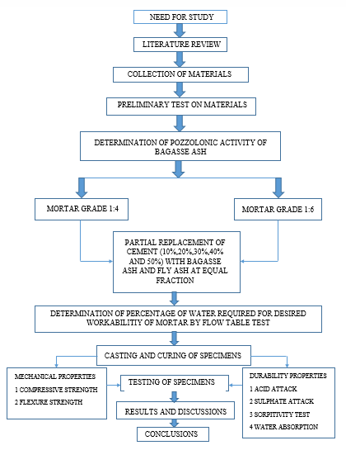
METHODOLOGY OF THE PROJECT

Slide 11
BRIEF DETAILS OF EXPERIMETNAL WORK
Details of test samples used in the project
Type of sample mould | Type of test | Size (mm)
Cube mould | compressive strength, acid and sulphate attack test, water absorption test and sorptivity test | 50x50x50 mm 70.6x70.6x70.6 mm
prism mould | flexural strength | 160x40x40 mm

Slide 12
Gradual replacement proportions of cement by fly ash and Sugarcane Bagasse ash for MM 7.5 Grade and MM3 3 Grade mortar with mix identity and W/C ratio
SI.No | Mortar mix identity | Mortar mix (MM7.5 Grade) | W/C ratio
1 | A1 | 1Cement (100%):4 sand | 0.77
2 | B1 | 1Cement (90% Cement+5% fly ash+5% bagasse ash):4 Sand | 1.02
3 | C1 | 1 Cement ( 80% Cement+10% flyash+10% Bagasse ash):4 Sand | 1.04
4 | D1 | 1 Cement (70% Cement+15% flyash+15% bagasse ash):4 Sand | 1.06
5 | E1 | 1 Cement (60%Cement+20% flyash+20% bagasse ash):4 Sand | 1.11
6 | F1 | 1 Cement ( 50% Cement+25% flyash+25% bagasse ash):4 Sand | 1.12
SI.No | Mortar mix identity | Mortar mix (MM 3 Grade) | W/C ratio
1 | A2 | 1Cement (100%):6 sand | 0.81
2 | B2 | 1Cement (90% Cement+5% fly ash+5% bagasse ash):6 Sand | 1.09
3 | C2 | 1 Cement ( 80% Cement+10% flyash+10% Bagasse ash):6 Sand | 1.23
4 | D2 | 1 Cement (70% Cement+15% flyash+15% bagasse ash):6 Sand | 1.28
5 | E2 | 1 Cement (60%Cement+20% flyash+20% bagasse ash):6 Sand | 1.38
6 | F2 | 1 Cement ( 50% Cement+25% flyash+25% bagasse ash):6 Sand | 1.7

Slide 13
MATERIAL USED IN PROPOSED WORK
The materials that are used in the preparation of specimen will have the effect on the strength and durability properties of the mortars. So the materials used in the casting of specimen are
OPC 43 grade cement
Manufactured sand
Sugar cane bagasse ash
Fly ash
Water

Slide 14
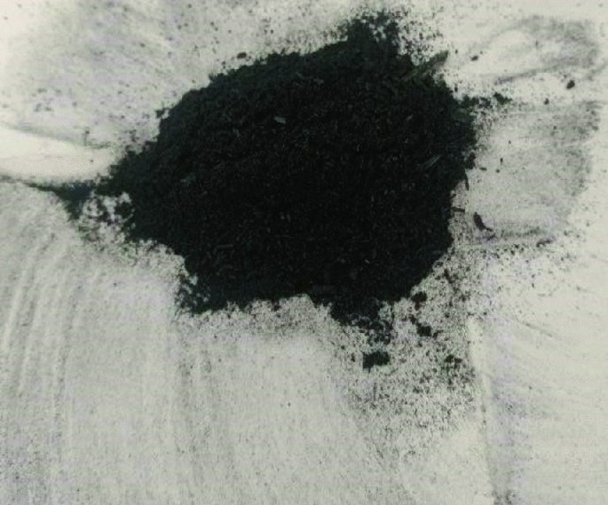
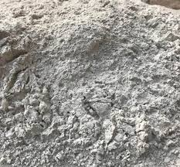
BAGASSE ASH AND FLY ASH SAMPLES
Bagasse ash
Fly ash

Slide 15
TEST RESULTS ON MATERIALS USED
TESTS ON CEMENT
Tests on cement
Tests | Results
Specific gravity of cement | 3.14
standard consistency of cement | 33%
Initial setting time | 35 minutes
Final setting time | 420 minutes

Slide 16
TESTS ON FINE AGGREGATE
Tests on fine aggregate
Tests | Results
Specific gravity of FA | 2.66
Water absorption of FA | 1%
Sieve analysis (Finess modulus) | 2.72

Slide 17
TESTS ON BAGASSE ASH AND FLY ASH Loss on ignition test
SI.No | Sample type | W1 (gm) | W2 (gm) | W3 (gm) | LOI value (%)
1 | Sample sieved through 300 micron | 35 | 52 | 47.4 | 27.05
2 | Sample sieved through 150 micron | 35 | 50 | 46.4 | 24
3 | Sample sieved through 90 micron | 35 | 50 | 49 | 6.67
4 | Sample sieved through 75 micron | 35 | 50 | 49 | 6.67
SI.No | Sample type | W1 (gm) | W2 (gm) | W3 (gm) | LOI value (%)
1 | Sample sieved through 300 micron | 36 | 51.6 | 51.33 | 1.73
2 | Sample sieved through 150 micron | 38 | 53.6 | 53.21 | 2.5
3 | Sample sieved through 90 micron | 35 | 46.2 | 45.57 | 5.625
4 | Sample sieved through 75 micron | 35.4 | 50.9 | 50.26 | 4.12
BAGASSE ASH FLY ASH

Slide 18
CONDUCTOMETERIC METHOD FOR BAGASSE ASH AND FLY ASH
Calculations for bagasse ash:
Sample taken =2.5 gms
Calcium hydroxide solution taken = 100 ml
Initial conductivity value = 4.35 mS
Final conductivity value (after 2 mins) = 3.56 mS
The ∆σ 2min value is greater than 0.4 hence the bagasse ash exhibits variable pozzolonicity
Calculations for fly ash:
Sample taken = 2.5 gms
Calcium hydroxide solution taken = 100 ml
Initial conductivity value = 6mS
Final conductivity value(after 2 mins) = 4.6 mS
The ∆σ 2min value is greater than 1.4 hence the fly ash exhibit good pozzolonicity

Slide 19

BAGASSE ASH SIEVING
Dry sieving results of bagasse ash
I.S Sieve size | Retained(gm) | Percentage Retained (%) | Cumulative Percentage Retained (F) | Percentage Passing (%)
300 | 20.1 | 8.04 | 8.04 | 91.96
150 | 166.9 | 66.76 | 74.8 | 25.2
Pan | 63 | 25.2 | 100 | 0
Weight of bagasse ash sample taken = 250gms
Fineness modulus = $\frac{∑F}{100}$ = $\frac{ 182.84}{100}$ = 1.82%

Slide 20

Wet sieving results of fly ash
Weight of sample takin = 100 grams
Weight of fly ash retained in 45 micron sieve after oven drying at 100$℃$ for 24 hours = 27.6 grams
Percentage of fly ash retained is $\frac{27.6}{100}$ x 100 = 27.6%

Slide 21
SPECIFIC GRAVITY OF BAGASSE ASH AND FLY ASH
SI.No | Sample size | Specific gravity
1 | Sample of bagasse ash passing through 150 micron sieve | 1.971
2 | Sample of fly ash passing through 150 micron sieve | 2.275
STANDARD CONSISTENCY , INITIAL SETTING AND FINAL SETTING TIME TESTS ON BLEDNED CEMENT
SI.No | Tests | cement | 10% replacement ( 5% bagasse ash 5% + fly ash) | 20% replacement ( 10% bagasse ash + 10% fly ash) | 30% replacement ( 15% bagasse ash + 15% fly ash) | 40% replacement ( 20% bagasse ash + 20% fly ash) | 50% replacement ( 25% bagasse ash + 25% fly ash)
1 | Standard consistency | 33% | 39% | 52% | 61% | 69% | 78%
2 | Initial setting time | 35 min | 145 min | 245 min | 300 min | 360 min | 400 min
3 | Final setting time | 420 | 600 | 720 | 815 | 940 | 1200

Slide 22
Flow test table for the mortars Results of flow table tests for 1:4 grade mortars
SI.No | percentage of bagasse ash and fly ash replacement in equal proportion for 1:4 | Water percentage (%)
1 | 0% | 77.5
2 | 10% | 101
3 | 20% | 104
4 | 30% | 105.7
5 | 40% | 116
6 | 50% | 121.7

Slide 23
Results of flow table tests for 1:6 grade mortars
SI.No | Percentage of bagasse ash and fly ash replacement in equal proportion for 1:6 | Water percentage (%)
1 | 0% | 81
2 | 10% | 110
3 | 20% | 121.2
4 | 30% | 127.5
5 | 40% | 134.5
6 | 50% | 176.6

Slide 24
RESULTS AND DISCUSSIONS
COMPRESSION TEST RESULTS AT 7 DAYS (1:4)
Compression test results for 1:4 proportion mortar for7 days
Mould size | Mortar mix identity | Sample | Load in kN | Stress in MPa | Average stress value in MPa | Compliance status (as per IS 2250:1981)
50x50x50 mm | A1 | cube 1 | 26 | 10.4 | 10.66 | MM 7.5 complied
 |  | cube 2 | 27 | 10.8
 |  | cube 3 | 27 | 10.8
 | B1 | cube 1 | 17.5 | 7 | 7.16 | MM 7.5 complied
 |  | cube 2 | 18 | 7.2
 |  | cube 3 | 18.2 | 7.28
 | C1 | cube 1 | 13.2 | 5.28 | 5.3 | MM 7.5 complied
 |  | cube 2 | 13 | 5.2
 |  | cube 3 | 13.6 | 5.44
 | D1 | cube 1 | 7.4 | 2.96 | 3 | MM 7.5 complied
 |  | cube 2 | 7.4 | 2.96
 |  | cube 3 | 7.8 | 3.12
 | E1 | cube 1 | 9.2 | 3.68 | 3.72 | MM 7.5 complied
 |  | cube 2 | 9.6 | 3.84
 |  | cube 3 | 9.1 | 3.64
 | F1 | cube 1 | 6.2 | 2.48 | 2.41 | MM 7.5 complied
 |  | cube 2 | 6 | 2.4
 |  | cube 3 | 5.9 | 2.36

Slide 25
COMPRESSION TEST RESULTS AT 28 DAYS (1:4)
Compression test results for 1:4 proportion mortar for 28 days
Mould size | Mortar mix identity | Sample | Load in kN | Stress in MPa | Average stress value in MPa | Compliance status (as per IS 2250:1981)
50x50x50 mm | A1 | cube 1 | 42 | 16.8 | 16.7 | MM 7.5 complied
 |  | cube 2 | 41.5 | 16.6
 |  | cube 3 | 41.8 | 16.72
 | B1 | cube 1 | 35.5 | 14.2 | 13.9 | MM 7.5 complied
 |  | cube 2 | 34.9 | 13.96
 |  | cube 3 | 34.1 | 13.64
 | C1 | cube 1 | 33 | 13.2 | 13.2 | MM 7.5 complied
 |  | cube 2 | 32.8 | 13.12
 |  | cube 3 | 33.1 | 13.24
 | D1 | cube 1 | 16 | 6.4 | 6.5 | MM 7.5 complied
 |  | cube 2 | 16.6 | 6.64
 |  | cube 3 | 16.52 | 6.608
 | E1 | cube 1 | 16 | 6.4 | 6.4 | MM 7.5 complied
 |  | cube 2 | 16 | 6.4
 |  | cube 3 | 16.1 | 6.44
 | F1 | cube 1 | 10.2 | 4.08 | 4.1 | MM 7.5 complied
 |  | cube 2 | 10.4 | 4.16
 |  | cube 3 | 10.1 | 4.04

Slide 26
COMPRESSION TEST RESULTS AT 56 DAYS (1:4)
Compressive strength results for 1:4 proportion mortar for 56 days
Mould size | Mortar mix identity | Sample | Load in kN | Stress in MPa | Average stress value in MPa | Compliance status (as per IS 2250:1981)
50x50x50 mm | A1 | cube 1 | 47.1 | 18.8 | 18.79 | MM 7.5 complied
 |  | cube 2 | 46.8 | 18.7
 |  | cube 3 | 47 | 18.8
 | B1 | cube 1 | 34 | 13.6 | 13.60 | MM 7.5 complied
 |  | cube 2 | 33.7 | 13.5
 |  | cube 3 | 34.3 | 13.7
 | C1 | cube 1 | 29 | 11.6 | 11.63 | MM 7.5 complied
 |  | cube 2 | 28.9 | 11.6
 |  | cube 3 | 29.3 | 11.7
 | D1 | cube 1 | 21 | 8.4 | 8.4 | MM 7.5 complied
 |  | cube 2 | 21 | 8.4
 |  | cube 3 | 21 | 8.4
 | E1 | cube 1 | 19 | 7.6 | 7.51 | MM 7.5 complied
 |  | cube 2 | 18.4 | 7.4
 |  | cube 3 | 18.9 | 7.6
 | F1 | cube 1 | 15.2 | 6.1 | 6.12 | MM 7.5 complied
 |  | cube 2 | 15.4 | 6.2
 |  | cube 3 | 15.3 | 6.1

Slide 27
COMPRESSION TEST RESULTS AT 7 DAYS (1:6)
Compression test results for 1:6 proportion mortar for 7 days
Mould size | Mortar mix identity | Sample | Load in kN | Stress in MPa | Average stress value in MPa | Compliance status (as per IS 2250:1981)
50x50x50 mm | A2 | cube 1 | 11.4 | 4.56 | 4.48 | MM 3 complied
 |  | cube 2 | 11 | 4.4
 |  | cube 3 | 11.2 | 4.48
 | B2 | cube 1 | 10.8 | 4.32 | 4.18 | MM 3 complied
 |  | cube 2 | 10.4 | 4.16
 |  | cube 3 | 10.2 | 4.08
 | C2 | cube 1 | 10.2 | 4.08 | 4.04 | MM 3 complied
 |  | cube 2 | 10 | 4
 |  | cube 3 | 10.1 | 4.04
 | D2 | cube 1 | 7.3 | 2.92 | 3.04 | MM 3 complied
 |  | cube 2 | 7.6 | 3.04
 |  | cube 3 | 7.9 | 3.16
 | E2 | cube 1 | 6.4 | 2.56 | 2.6 | MM 3 complied
 |  | cube 2 | 6.8 | 2.72
 |  | cube 3 | 6.3 | 2.52
 | F2 | cube 1 | 3 | 1.2 | 1.29 | MM 3 complied
 |  | cube 2 | 3.5 | 1.4
 |  | cube 3 | 3.2 | 1.28

Slide 28
COMPRESSION TEST RESULTS AT 28 DAYS (1:6)
Compression test results For 1:6 proportion mortar for 28 days
Mould size | Mortar mix identity | Sample | Load in kN | Stress in MPa | Average stress value in MPa | Compliance status (as per IS 2250:1981)
50x50x50 mm | A2 | cube 1 | 32 | 12.8 | 12.8 | MM 3 complied
 |  | cube 2 | 32.1 | 12.84
 |  | cube 3 | 31.9 | 12.76
 | B2 | cube 1 | 22 | 8.8 | 8.88 | MM 3 complied
 |  | cube 2 | 22.4 | 8.96
 |  | cube 3 | 22.2 | 8.88
 | C2 | cube 1 | 16 | 6.4 | 6.54 | MM 3 complied
 |  | cube 2 | 16.9 | 6.76
 |  | cube 3 | 16.2 | 6.48
 | D2 | cube 1 | 16 | 6.4 | 6.4 | MM 3 complied
 |  | cube 2 | 16 | 6.4
 |  | cube 3 | 16 | 6.4
 | E2 | cube 1 | 11.6 | 4.64 | 4.56 | MM 3 complied
 |  | cube 2 | 11.2 | 4.48
 |  | cube 3 | 11.4 | 4.56
 | F2 | cube 1 | 8.4 | 3.36 | 3.37 | MM 3 complied
 |  | cube 2 | 8.8 | 3.52
 |  | cube 3 | 8.1 | 3.24

Slide 29
COMPRESSION TEST RESULTS AT 56 DAYS (1:6)
Compression strength results for 1:6 proportion mortar for 56 days
Mould size | Mortar mix identity | Sample | Load in kN | Stress in MPa | Average stress value in MPa | Compliance status (as per IS 2250:1981)
50x50x50 mm | A2 | cube 1 | 35.9 | 14.4 | 14.39 | MM 3 complied
 |  | cube 2 | 36 | 14.4
 |  | cube 3 | 36 | 14.4
 | B2 | cube 1 | 25 | 10.0 | 10 | MM 3 complied
 |  | cube 2 | 24.8 | 9.9
 |  | cube 3 | 25.2 | 10.1
 | C2 | cube 1 | 22 | 8.8 | 8.84 | MM 3 complied
 |  | cube 2 | 22 | 8.8
 |  | cube 3 | 22.3 | 8.9
 | D2 | cube 1 | 17 | 6.8 | 6.85 | MM 3 complied
 |  | cube 2 | 17.1 | 6.8
 |  | cube 3 | 17.3 | 6.9
 | E2 | cube 1 | 13 | 5.2 | 5.2 | MM 3 complied
 |  | cube 2 | 12.9 | 5.2
 |  | cube 3 | 13.1 | 5.2
 | F2 | cube 1 | 10.2 | 4.1 | 4.08 | MM 3 complied
 |  | cube 2 | 10 | 4.0
 |  | cube 3 | 10.4 | 4.2

Slide 30
FLEXURAL STRENGTH TEST RESULTS AT 7 DAYS (1:4)
Flexure Strength test results For 1:4 proportion mortar for 7 days
Mould size | Mortar mix identity | Sample | Breaking load in kN | Bending strength in MPa | Average strength value in MPa
160x40x40 mm | A1 | cube 1 | 2.8 | 3.5 | 3.3
 |  | cube 2 | 2.6 | 3.2
 |  | cube 3 | 2.65 | 3.3
 | B1 | cube 1 | 1.8 | 2.2 | 2.2
 |  | cube 2 | 1.78 | 2.2
 |  | cube 3 | 1.72 | 2.1
 | C1 | cube 1 | 1.2 | 1.5 | 1.5
 |  | cube 2 | 1.28 | 1.6
 |  | cube 3 | 1.22 | 1.5
 | D1 | cube 1 | 1 | 1.2 | 1.2
 |  | cube 2 | 1 | 1.2
 |  | cube 3 | 0.95 | 1.2
 | E1 | cube 1 | 0.7 | 0.9 | 0.9
 |  | cube 2 | 0.75 | 0.9
 |  | cube 3 | 0.69 | 0.9
 | F1 | cube 1 | 0.6 | 0.7 | 0.7
 |  | cube 2 | 0.59 | 0.7
 |  | cube 3 | 0.61 | 0.8

Slide 31
FLEXURAL STRENGTH TEST RESULTS AT 28 DAYS (1:4)
Flexure Strength test results for 1:4 proportion mortar for 28 days
Mould size | Mortar mix identity | Sample | Breaking load in kN | Bending strength in MPa | Average strength value in MPa
160x40x40 mm | A1 | cube 1 | 3.6 | 4.5 | 4.4
 |  | cube 2 | 3.52 | 4.4
 |  | cube 3 | 3.58 | 4.4
 | B1 | cube 1 | 2.5 | 3.1 | 3.1
 |  | cube 2 | 2.52 | 3.1
 |  | cube 3 | 2.51 | 3.1
 | C1 | cube 1 | 2.15 | 2.7 | 2.7
 |  | cube 2 | 2.2 | 2.7
 |  | cube 3 | 2.2 | 2.7
 | D1 | cube 1 | 2 | 2.5 | 2.5
 |  | cube 2 | 2 | 2.5
 |  | cube 3 | 2 | 2.5
 | E1 | cube 1 | 0.7 | 0.9 | 0.9
 |  | cube 2 | 0.69 | 0.9
 |  | cube 3 | 0.68 | 0.8
 | F1 | cube 1 | 0.6 | 0.7 | 0.7
 |  | cube 2 | 0.58 | 0.7
 |  | cube 3 | 0.61 | 0.8

Slide 32
FLEXURAL STRENGTH TEST RESULTS AT 56 DAYS (1:4)
Flexure Strength test results for 1:4 proportion mortar for 56 days
Mould size | Mortar mix identity | Sample | Breaking load in kN | Bending strength in MPa | Average strength value in MPa
160x40x40 mm | A1 | cube 1 | 4 | 5.0 | 5.0
 |  | cube 2 | 3.9 | 4.8
 |  | cube 3 | 4.1 | 5.1
 | B1 | cube 1 | 2.8 | 3.5 | 3.4
 |  | cube 2 | 2.8 | 3.5
 |  | cube 3 | 2.7 | 3.4
 | C1 | cube 1 | 2.6 | 3.2 | 3.1
 |  | cube 2 | 2.44 | 3.0
 |  | cube 3 | 2.52 | 3.1
 | D1 | cube 1 | 2.3 | 2.9 | 2.9
 |  | cube 2 | 2.3 | 2.9
 |  | cube 3 | 2.3 | 2.9
 | E1 | cube 1 | 1.4 | 1.7 | 1.7
 |  | cube 2 | 1.4 | 1.7
 |  | cube 3 | 1.4 | 1.7
 | F1 | cube 1 | 1 | 1.2 | 1.2
 |  | cube 2 | 1 | 1.2
 |  | cube 3 | 1 | 1.2

Slide 33
FLEXURAL STRENGTH TEST RESULTS AT 7 DAYS (1:6)
Flexure Strength test results For 1:6 proportion mortar for 7 days
Mould size | Mortar mix identity | Sample | Breaking load in kN | Bending strength in MPa | Average strength value in MPa
160x40x40 mm | A2 | cube 1 | 2.2 | 2.7 | 2.6
 |  | cube 2 | 2.17 | 2.7
 |  | cube 3 | 2 | 2.5
 | B2 | cube 1 | 1.4 | 1.7 | 1.7
 |  | cube 2 | 1.38 | 1.7
 |  | cube 3 | 1.41 | 1.8
 | C2 | cube 1 | 1 | 1.2 | 1.2
 |  | cube 2 | 1 | 1.2
 |  | cube 3 | 1 | 1.2
 | D2 | cube 1 | 0.8 | 1.0 | 1.0
 |  | cube 2 | 0.74 | 0.9
 |  | cube 3 | 0.79 | 1.0
 | E2 | cube 1 | 0.4 | 0.5 | 0.5
 |  | cube 2 | 0.42 | 0.5
 |  | cube 3 | 0.38 | 0.5
 | F2 | cube 1 | 0.3 | 0.4 | 0.4
 |  | cube 2 | 0.32 | 0.4
 |  | cube 3 | 0.3 | 0.4

Slide 34
FLEXURAL STRENGTH TEST RESULTS AT 28 DAYS (1:6)
Flexure Strength test results for 1:6 proportion mortar for 28 days
Mould size | Mortar mix identity | Sample | Breaking load in kN | Bending strength in MPa | Average strength value in MPa
160x40x40 mm | A2 | cube 1 | 2.7 | 3.4 | 3.3
 |  | cube 2 | 2.71 | 3.4
 |  | cube 3 | 2.68 | 3.3
 | B2 | cube 1 | 1.8 | 2.2 | 2.3
 |  | cube 2 | 1.9 | 2.4
 |  | cube 3 | 1.78 | 2.2
 | C2 | cube 1 | 1.9 | 2.4 | 2.4
 |  | cube 2 | 1.9 | 2.4
 |  | cube 3 | 1.9 | 2.4
 | D2 | cube 1 | 1 | 1.2 | 1.2
 |  | cube 2 | 1 | 1.2
 |  | cube 3 | 1 | 1.2
 | E2 | cube 1 | 0.6 | 0.7 | 0.8
 |  | cube 2 | 0.61 | 0.8
 |  | cube 3 | 0.62 | 0.8
 | F2 | cube 1 | 0.55 | 0.7 | 0.6
 |  | cube 2 | 0.5 | 0.6
 |  | cube 3 | 0.5 | 0.

Slide 35
FLEXURAL STRENGTH TEST RESULTS AT 56 DAYS (1:6)
Flexure Strength test results for 1:6 proportion mortar for 56 days
Mould size | Mortar mix identity | Sample | Breaking load in kN | Bending strength in MPa | Average strength value in MPa
160x40x40 mm | A2 | cube 1 | 2.9 | 3.6 | 3.6
 |  | cube 2 | 2.92 | 3.6
 |  | cube 3 | 2.9 | 3.6
 | B2 | cube 1 | 2.1 | 2.6 | 2.7
 |  | cube 2 | 2.1 | 2.6
 |  | cube 3 | 2.2 | 2.7
 | C2 | cube 1 | 2.3 | 2.9 | 2.9
 |  | cube 2 | 2.3 | 2.9
 |  | cube 3 | 2.3 | 2.9
 | D2 | cube 1 | 1.2 | 1.5 | 1.6
 |  | cube 2 | 1.4 | 1.7
 |  | cube 3 | 1.2 | 1.5
 | E2 | cube 1 | 1 | 1.2 | 1.2
 |  | cube 2 | 1 | 1.2
 |  | cube 3 | 1 | 1.2
 | F2 | cube 1 | 0.8 | 1.0 | 1.0
 |  | cube 2 | 0.85 | 1.1
 |  | cube 3 | 0.8 | 1.0

Slide 36
COMPARSION OF 7, 28 AND 56 DAYS COMPRESSIVE STRENGTH OF MORTARS SHOWS COMPRESSIVE STRENGTH OF 7, 28 AND 56 DAYS (1:4)RATIO

Slide 37
SHOWS COMPRESSIVE STRENGTH OF 7, 28 AND 56 DAYS (1:6)RATIO

Slide 38
COMPARSION OF 7, 28 AND 56 DAYS FLEXURAL STRENGTH OF MORTARS SHOWS FLEXURAL STRENGTH OF 7, 28 AND 56 DAYS (1:4)RATIO

Slide 39
SHOWS FLEXURAL STRENGTH OF 7, 28 AND 56 DAYS (1:6)RATIO

Slide 40
DURABILITY TEST RESULTS ACID ATTACK RESULTS
Acid attack results for 7 days
SI.No | Mix design code | Size of specimen | Initial weight of the sample (average of three) in gms | Loss of weight the sample after 7 days immersion in HCL (average of three) in gms | Percentage loss after 7 days (%)
1 | A1 | 50x50 mm | 259 | 255 | 1.67
2 | A2 |  | 236 | 232 | 1.41
3 | B1 |  | 268 | 261 | 2.49
4 | B2 |  | 250 | 245 | 2.13
5 | C1 |  | 259 | 252 | 2.83
6 | C2 |  | 258 | 248 | 3.88
7 | D1 |  | 254 | 240 | 5.38
8 | D2 |  | 253 | 235 | 6.99
9 | E1 |  | 256 | 241 | 5.86
10 | E2 |  | 250 | 235 | 5.87
11 | F1 |  | 254 | 236 | 6.96
12 | F2 |  | 254 | 241 | 5.87

Slide 41
Acid attack results for 14 days
SI.No | Mix design code | Size of specimen | Initial weight of the sample (average of three) in gms | Loss of weight the sample after 14 days immersion in HCL (average of three) in gms | Percentage loss after 14 days (%)
1 | A1 | 50x50 mm | 259 | 251 | 3.09
2 | A2 |  | 236 | 228 | 3.39
3 | B1 |  | 268 | 254 | 5.22
4 | B2 |  | 250 | 234 | 6.40
5 | C1 |  | 259 | 236 | 8.88
6 | C2 |  | 258 | 241 | 6.59
7 | D1 |  | 254 | 236 | 7.09
8 | D2 |  | 253 | 223 | 11.86
9 | E1 |  | 256 | 226 | 11.72
10 | E2 |  | 250 | 231 | 7.60
11 | F1 |  | 254 | 230 | 9.45
12 | F2 |  | 254 | 238 | 6.30

Slide 42
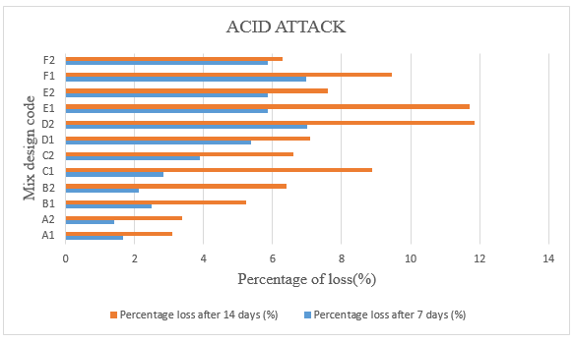
COMPARSION OF 7 AND 14 DAYS ACID ATTACK RESULTS

Slide 43
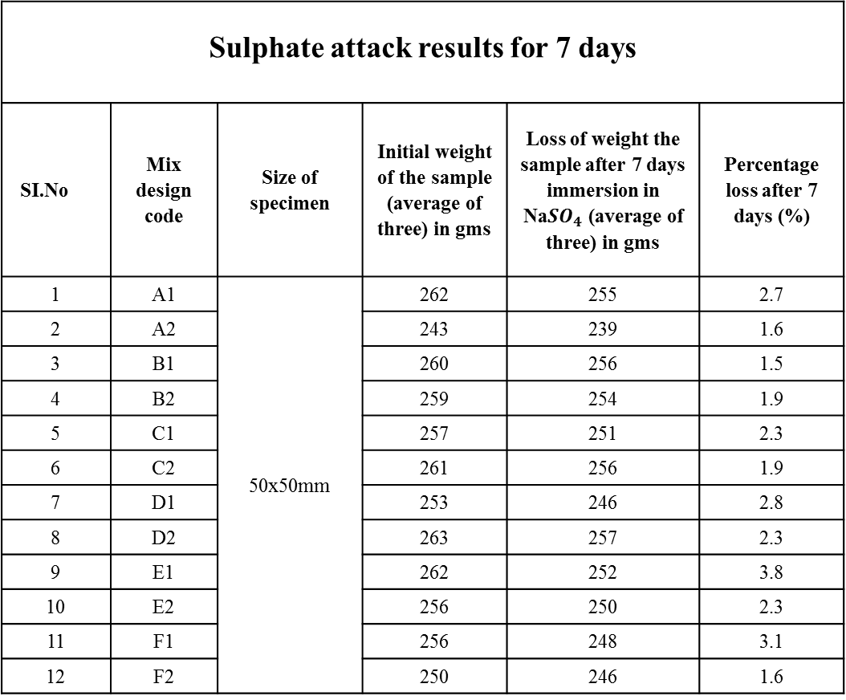
SULPHATE ATTACK TEST RESULTS
Sulphate attack results for 7 days
SI.No | Mix design code | Size of specimen | Initial weight of the sample (average of three) in gms | Loss of weight the sample after 7 days immersion in Na${SO}_{4}$ (average of three) in gms | Percentage loss after 7 days (%)
1 | A1 | 50x50mm | 262 | 255 | 2.7
2 | A2 |  | 243 | 239 | 1.6
3 | B1 |  | 260 | 256 | 1.5
4 | B2 |  | 259 | 254 | 1.9
5 | C1 |  | 257 | 251 | 2.3
6 | C2 |  | 261 | 256 | 1.9
7 | D1 |  | 253 | 246 | 2.8
8 | D2 |  | 263 | 257 | 2.3
9 | E1 |  | 262 | 252 | 3.8
10 | E2 |  | 256 | 250 | 2.3
11 | F1 |  | 256 | 248 | 3.1
12 | F2 |  | 250 | 246 | 1.6

Slide 44
Sulphate attack results for 14 days
SI.No | Mix design code | Size of specimen | Initial weight of the sample (average of three) in gms | Loss of weight the sample after 14 days immersion in NaSo4 (average of three) in gms | Percentage loss after 14 days (%)
1 | A1 | 50x50mm | 262 | 250 | 4.6
2 | A2 |  | 243 | 228 | 6.2
3 | B1 |  | 260 | 241 | 7.3
4 | B2 |  | 259 | 246 | 5.0
5 | C1 |  | 257 | 239 | 7.0
6 | C2 |  | 261 | 242 | 7.3
7 | D1 |  | 253 | 238 | 5.9
8 | D2 |  | 263 | 244 | 7.2
9 | E1 |  | 262 | 240 | 8.4
10 | E2 |  | 256 | 234 | 8.6
11 | F1 |  | 256 | 231 | 9.8
12 | F2 |  | 250 | 228 | 8.8

Slide 45
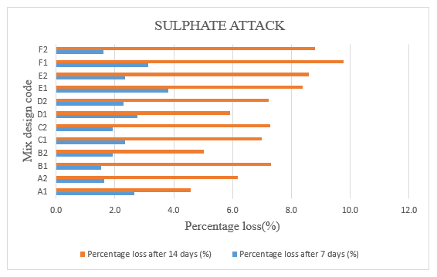
COMPARSION OF 7 AND 14 DAYS SULPHATE ATTACK RESULTS

Slide 46
WATER ABSORPTION TEST RESULTS
SI.No | Replacement code | Size of specimen | sample number | initial weight of 28 days cured oven dried sample (A) | Final weight of 24 hours soaked surface dried sample (B) | Percentage of water absorption (%)
1 | A1 | 50 x 50 x 50 mm | 1 | 242 | 259 | 7.02
 |  |  | 2 | 243 | 263 | 8.23
 |  |  | 3 | 246 | 262 | 6.50
2 | A2 | 50 x 50 x 50 mm | 1 | 214 | 240 | 12.15
 |  |  | 2 | 218 | 237 | 8.72
 |  | 70.6 x 70.6 x 70.6 mm | 3 | 639 | 717 | 12.21
3 | B1 | 50 x 50 x 50 mm | 1 | 264 | 287 | 8.71
 |  |  | 2 | 249 | 272 | 9.24
 |  |  | 3 | 246 | 270 | 9.76
4 | B2 | 50 x 50 x 50 mm | 1 | 248 | 269 | 8.47
 |  |  | 2 | 242 | 260 | 7.44
 |  | 70.6 x 70.6 x 70.6 mm | 3 | 674 | 737 | 9.35
5 | C1 | 50 x 50 x 50 mm | 1 | 257 | 282 | 9.73
 |  |  | 2 | 238 | 262 | 10.08
 |  |  | 3 | 234 | 257 | 9.83
6 | C2 | 50 x 50 x 50 mm | 1 | 223 | 246 | 10.31
 |  |  | 2 | 219 | 242 | 10.50

Slide 47
7 | D1 | 50 x 50 x 50 mm | 1 | 242 | 270 | 11.57
 |  |  | 2 | 248 | 263 | 6.05
 |  |  | 3 | 236 | 254 | 7.63
8 | D2 | 50 x 50 x 50 mm | 1 | 236 | 263 | 11.44
 |  |  | 2 | 232 | 259 | 11.64
 |  | 70.6 x 70.6 x 70.6 mm | 3 | 724 | 795 | 9.81
9 | E1 | 50 x 50 x 50 mm | 1 | 238 | 264 | 10.92
 |  |  | 2 | 223 | 249 | 11.66
 |  |  | 3 | 217 | 237 | 9.22
10 | E2 | 50 x 50 x 50 mm | 1 | 244 | 269 | 10.25
 |  |  | 2 | 241 | 266 | 10.37
 |  | 70.6 x 70.6 x 70.6 mm | 3 | 678 | 753 | 11.06
11 | F1 | 50 x 50 x 50 mm | 1 | 219 | 246 | 12.33
 |  |  | 2 | 217 | 247 | 13.82
 |  |  | 3 | 221 | 251 | 13.57
12 | F2 | 50 x 50 x 50 mm | 1 | 231 | 256 | 10.82
 |  |  | 2 | 238 | 264 | 10.92
 |  | 70.6 x 70.6 x 70.6 mm | 3 | 694 | 773 | 11.38

Slide 48
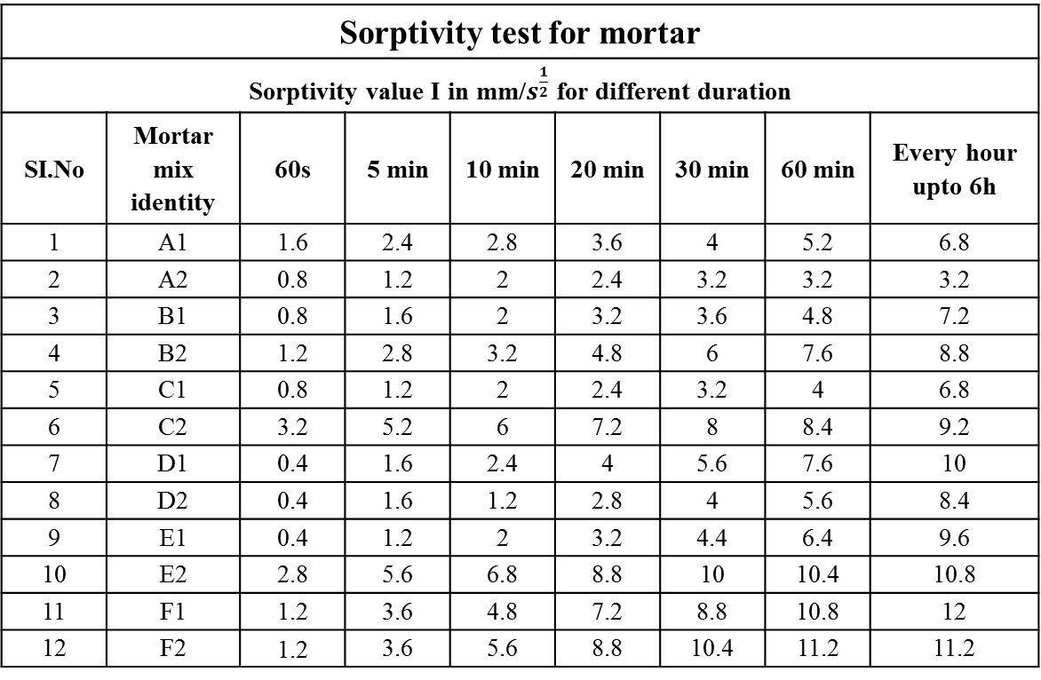
SORPTIVITY TEST RESULTS
Sorptivity test for mortar
Sorptivity value I in mm/$s^{\frac{1}{2}}$ for different duration
SI.No | Mortar mix identity | 60s | 5 min | 10 min | 20 min | 30 min | 60 min | Every hour upto 6h
1 | A1 | 1.6 | 2.4 | 2.8 | 3.6 | 4 | 5.2 | 6.8
2 | A2 | 0.8 | 1.2 | 2 | 2.4 | 3.2 | 3.2 | 3.2
3 | B1 | 0.8 | 1.6 | 2 | 3.2 | 3.6 | 4.8 | 7.2
4 | B2 | 1.2 | 2.8 | 3.2 | 4.8 | 6 | 7.6 | 8.8
5 | C1 | 0.8 | 1.2 | 2 | 2.4 | 3.2 | 4 | 6.8
6 | C2 | 3.2 | 5.2 | 6 | 7.2 | 8 | 8.4 | 9.2
7 | D1 | 0.4 | 1.6 | 2.4 | 4 | 5.6 | 7.6 | 10
8 | D2 | 0.4 | 1.6 | 1.2 | 2.8 | 4 | 5.6 | 8.4
9 | E1 | 0.4 | 1.2 | 2 | 3.2 | 4.4 | 6.4 | 9.6
10 | E2 | 2.8 | 5.6 | 6.8 | 8.8 | 10 | 10.4 | 10.8
11 | F1 | 1.2 | 3.6 | 4.8 | 7.2 | 8.8 | 10.8 | 12
12 | F2 | 1.2 | 3.6 | 5.6 | 8.8 | 10.4 | 11.2 | 11.2

Slide 49

COMPARSION OF SORPTIVITY TESTS RESULTS FOR DIFFERENT GRADE OF MORTARS
Absorption I in mm/$s^{1/2}$

Slide 50
7. CONCLUSIONS
The compressive strength results have concluded that the initial gain in strength (7 days ) was less and there is very large increase in strength for 28 days cured specimen due to increase in hydration rate after 7 days.
There is not much increase in strength for 56 days specimens due to 90% hydration within 28 days.
The flexural strength results have concluded that the initial gain in strength (7 days) was less and there is very large increase in strength for 28 days cured specimen.
It is notice that the flexural strength of the conventional mortar is considerably high compared to that of the mortar in which cement is replaced in varying percentage of bagasse ash and fly ash.
The flexural strength of the mortar for mix proportion 1:6 ratio is very low and the highest achieved was 3.6 MPa for 56 days.
The nominal compressive and flexural strength is observed at 20 % replacement when compared to conventional mortar.
Minimum strength in compression for MM3 and MM7.5 mortar is achieved as per IS 2250:1981.

Slide 51
The sorptivity test is conducted for both mortar grades after 28 days of curing specimens and it has observed that capillary rise in water reached the saturation level within two hours of test due to complete filling of pores in mortar.
It observed the % of water absorption of oven dry sample is less 15 % which is conducted as per BS: 1881:Part 122.
The sulphate attack and acid attack results have concluded that the percentage loss of 15% and 10% respectively.

Slide 52
REFERENCES
1.ABHISH M, “Study on blended cement composites with 53 grade OPC composites for marine condition”, IJERT, volume 4 issue2, March 2015.
2.B.T. NAVEEN KUMAR, “The Experimental Study on Behavior of Blended Cement Concrete with 80% Replaced with Nano-Metakaolin and Steel Slag at Elevated Temperature”, Publish shine India, volume 2, issue1, August 2016.
3.CHOW WEE KANG, “The properties of slag-silica fume ternary blended mortar with quarry dust”, journal of mechanical engineering and sciences, Volume 4, issue 1, PP-6443-6451.
4.CHANDRASEKHAR REDDY K, “Experimental Studies on Durability and Mechanical Characteristics of Concrete using POFA and SCBA hybridization”, Australian Journal of Structural Engineering, Volume 23,May 2022,PP 12-14.
5.CHIDABARAM PRITHVURAJ, “Assessment of strength of durability characteristics of self-compacting mortar” Sustainability, Volume 2, issue 4, May 2022, PP 221-228
6.CORDEIRO ANDREA, “Pozzolanic properties of ultrafine bagasse ash produced by controlled burning”, www.Elsevier.com, September 2019, PP110-115.
7.DODDA SRINIVAS, “Experimental characterization of quaternary blended mortar exposed to marine environment using mechanical strength, corrosion resistance and chemical composition”, www.Elsevier.com, Volume 42, October 202, PP 384-389.
8.JORGE I. TOBON, “Study of durability of Portland cement mortars blended with silica nanoparticles”, www.Elsevier.com, August, 2014, PP 92-97.

Slide 53
9.J.PONNAIAH, “Natural admixture in blended mortar- mechanical properties study”, www.Elsevier.com, , May 2020,PP102-107.
10.SHEBA BABU, “Mechanical properties of blended cement mortar systems exposed to ammonium chloride environment”, ”, International Virtual Conference on Emerging Research Trends in Structural Engineering, Volume 989, July 2020, PP 16-17.
11.YEN LI, “Properties of Cement Mortar Produced from Mixed Waste Materials with Pozzolanic Characteristics”, www.Elsevier.com July 2012, PP 638-645.
12.YUNFENG LI, “Environment-friendly Concrete and Cement Mortar Mixed with Steel Slag”, Engineering, Science, Construction, and Operations in Challenging Environments, January 2010, PP 410-418.
13.IS 1727 (1967), “Method of test for pozzolon material” BIS, October 1996
14.IS 4031-7 “Methods of physical tests for hydraulic cement”, Part -7, BIS, March 1998.
15.IS 1905:1987 “Code of practice for structural use of unreinforced masonry”, BIS, November 1995.
16.IS 2250 (1981), “Code of practice for preparation and use of masonry mortars”, BIS, February 1995
17.IS 2386 – Part 3, “Determination of specific gravity, voids, absorption and bulking “BIS, March 1977.

Slide 54
18.IS 2386 – Part 1, “Methods of testing of aggregate for concrete”, “Determination of particle size and shape” BIS, August 1977.
19.IS 4031 –part 4 “Methods of physical tests for hydraulic cement”, “Determination of standard consistency of cement paste” BIS, September 1977.
20. IS 4031 –part 5, “Methods of physical tests for hydraulic cement”, “Determination of initial and final setting time of cement”, BIS, March 2005.
21.IS516- 1959, “Method of tests for strength of concrete” “Determination of flexural strength of concrete” BIS, June 2016.
22.ASTM C1585 -13 “Determination of sorptivity test on mortars cubes”, June 17, 2012.
23.ASTM C 1012-04 “Determination of Sulphate attack on mortar cubes”, April 16, 2006.
24.ASTM C 267 “Determination of acid attack on mortar cubes”, April 16, 2016.
25.BS 1881: Part122 “Determination of water absorption test for mortar cubes” Jully15, 2013.
26.P. M BOBBY, “The performance of multi blended cement concrete in marine environment”, IJICIET, Volume 8, Issue 7, July 2017, PP. 219–231.

Slide 55
THANK YOU

